Slide 1
Texas Local Fire Fighters Retirement Act
Education Conference
The Economy and Portfolio Positioning
October 2022
Tim Barrett, CFA
Chief Investment Officer
Texas Tech University System

Slide 2
Discussion Points
The Great Monetary Experiment (GME) – How did we get here?
Impact of GME
When will inflation subside?
Positioning considerations, given the economic and market environment.

Slide 3
US Monetary Policy Basics

Slide 4
QE Basics
.
The Treasury issues debt securities, which are purchased by a
primary dealer. The Fed creates bank reserves (a liability) on the balance sheet and uses them to purchase securities in the open market from primary dealers.
QE is a liquidity management tool; purchasing securities in the open market injects liquidity into the financial system. It increases the money supply and acts as a signaling mechanism to the market for ample liquidity and easy financial conditions. QE is oftentimes used when short-term rates are low, and the economy needs additional assistance.

Slide 5
A History of FED Open Market Ops
QE1
QE2
Operation Twist
QE3
Quantitative Accommodation
Balance Sheet Normalization
Balance Sheet Expansion
Tapering

Slide 6
The U.S. Economy
PAST:
The Fed, Treasury & Congress, since the GFC, have embarked on easy monetary policy, untested balance sheet expansion through Quantitative Easing (QE), as well as open market operations shoring up the repo market.
Covid accelerated the policy responses, stoking the flames of inflation.
PRESENT:
Too low for too long >> Is now turning into rapid rate rises and QT, likely for too long.
Remember: Inflation was Transitory; new Fed lingo – a Soft Landing.

Slide 7
Result of QE, stimulus and Covid demand shock
Inflation

Slide 8
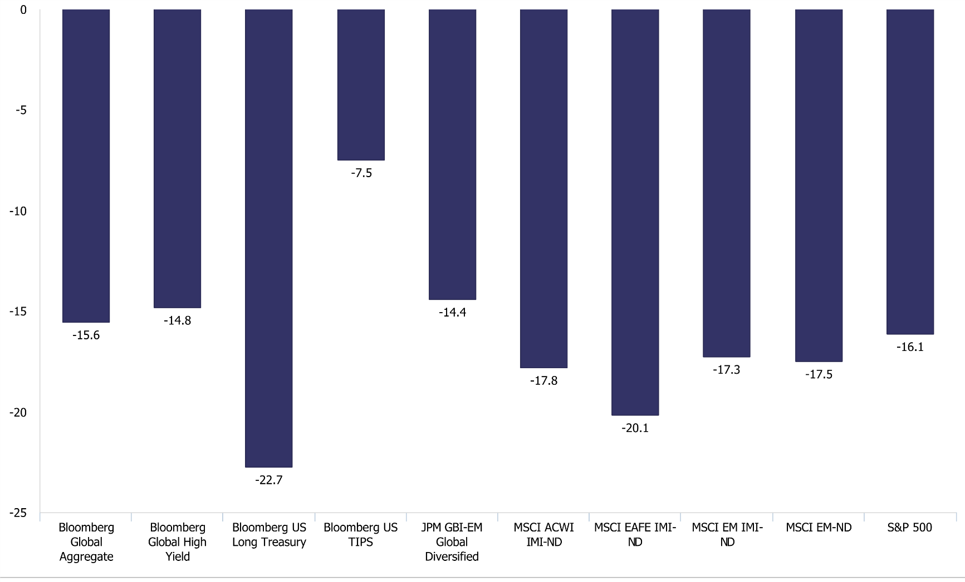
Market response to Inflation, YTD through August 2022
Notes: 2022 bear market is ongoing; represents historical bear markets since 1970. *Length of Recovery represents time to recoup losses from the start of the bear market.
Sources: S&P, FactSet, NEPC

Slide 9
Bear Markets – historical context.
Notes: 2022 bear market is ongoing; represents historical bear markets since 1970. *Length of Recovery represents time to recoup losses from the start of the bear market.
Sources: S&P, FactSet, NEPC

Slide 10
Inflation

Slide 11
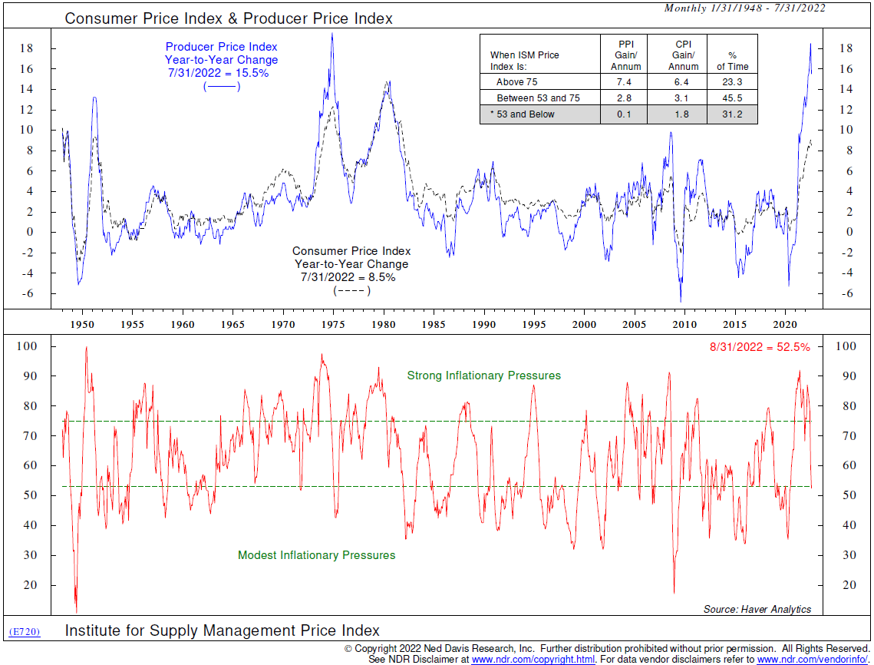
ISM Price Index = modest inflationary pressure
Inflation appears to have peaked based on latest PPI and CPI reports.
The ISM price index has fallen to a level consistent with the Fed’s 2% target level, on a hypothetical basis.

Slide 12
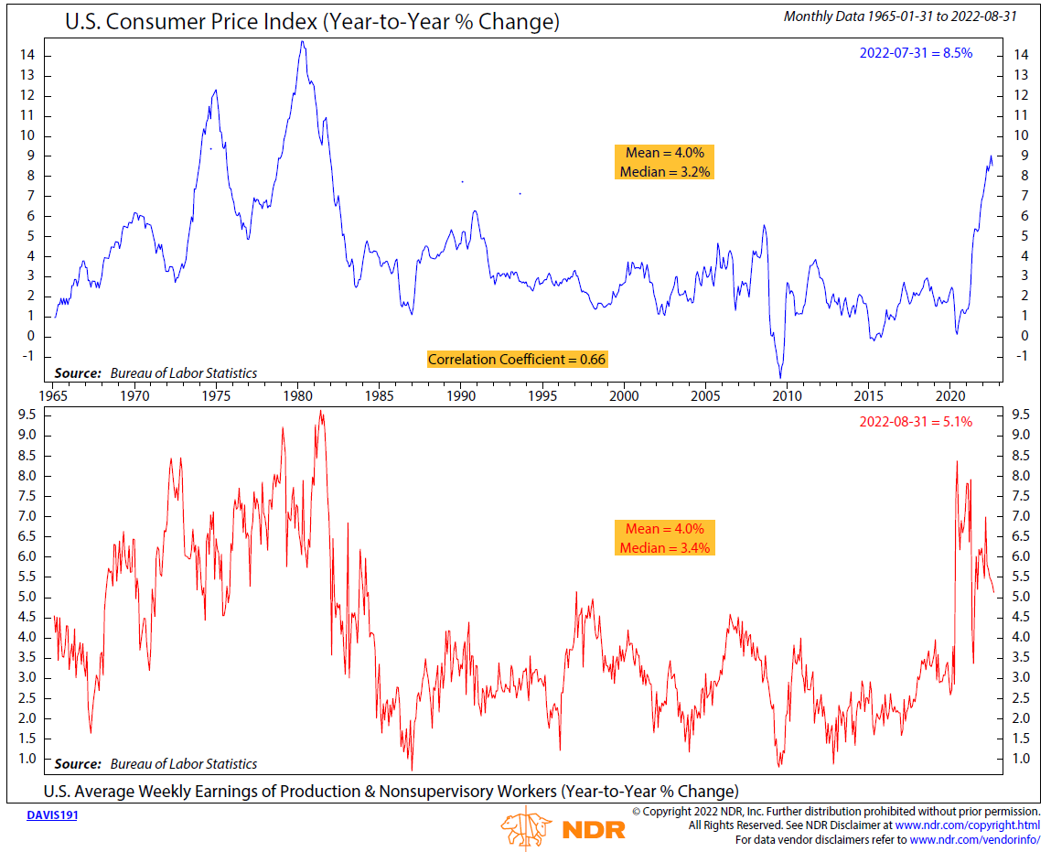
Weekly wage growth continues to fall
In real terms, wages are falling which is inconsistent with higher inflation. Not included in this chart, GDI was revised down on 9/28/22, coming in at 0.8% vs the estimated 1.8%. In short, wage growth is not coming in as hot as expected.

Slide 13
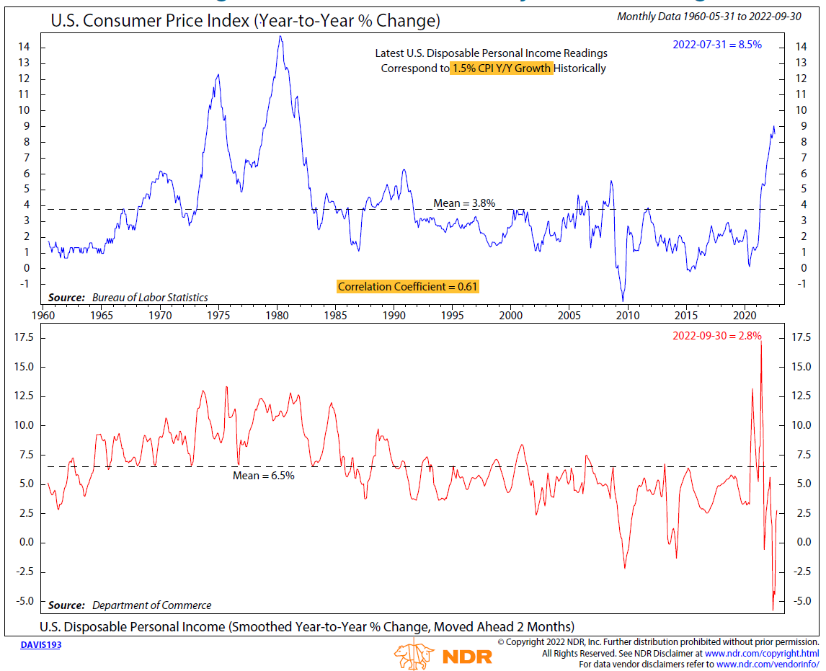
Current Income growth consistent with just 1.5% CPI growth
While wage growth and disposable income are more consistent with lower inflation, the nest eggs built by consumers in the Covid lockdowns still provide room for services to continue to run hot.
With that said, wages and income do point to lower inflation.

Slide 14
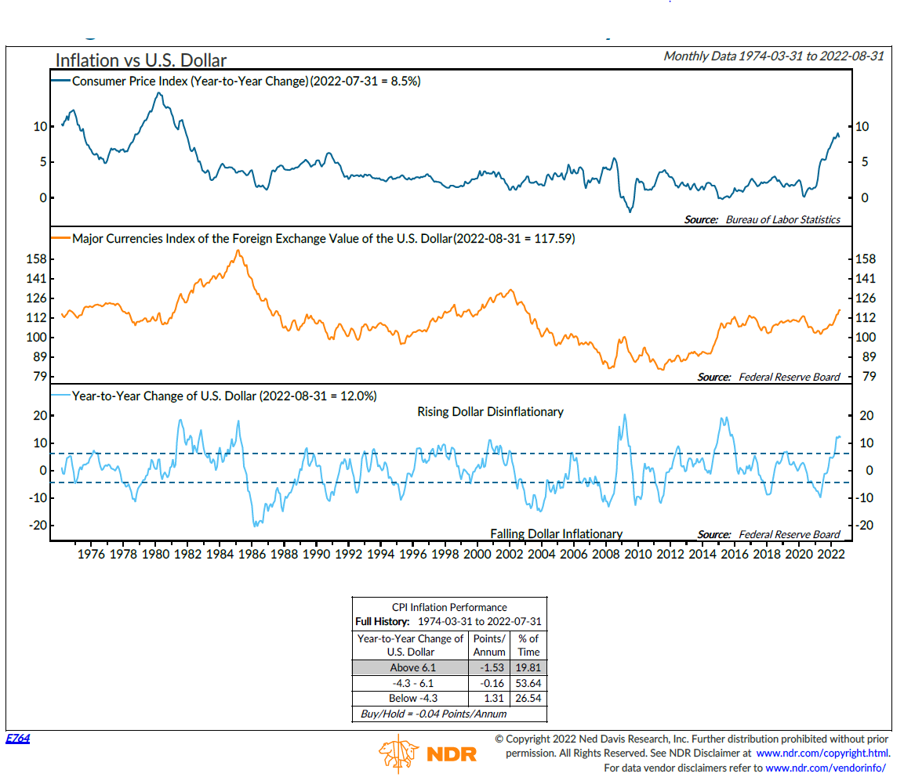
Strong dollar continues to be disinflationary
A strong dollar is consistent with falling inflation. In short, we are exporting inflation to the rest of the world.

Slide 15
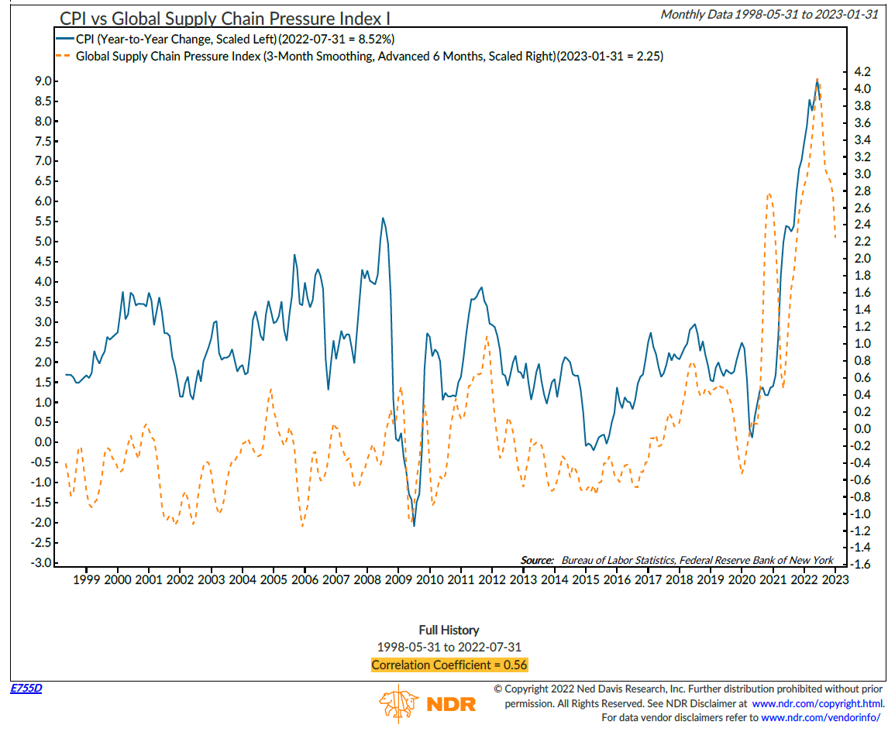
Global supply chain pressures falling, suggesting CPI will follow
Global supply chain pressures are falling sharply, especially supplier delivery times, trucking and shipping rates, as well as fuel.

Slide 16
Global supply chain –Supplier Delivery Times and New Orders
Although delivery times are still elevated, supply chain issues have eased substantially
Rising inventories are now outweighing new orders which points to downward pressure on prices
Source: ISM Manufacturing PMIs from 01/01/2013 to 08/31/2022

Slide 17
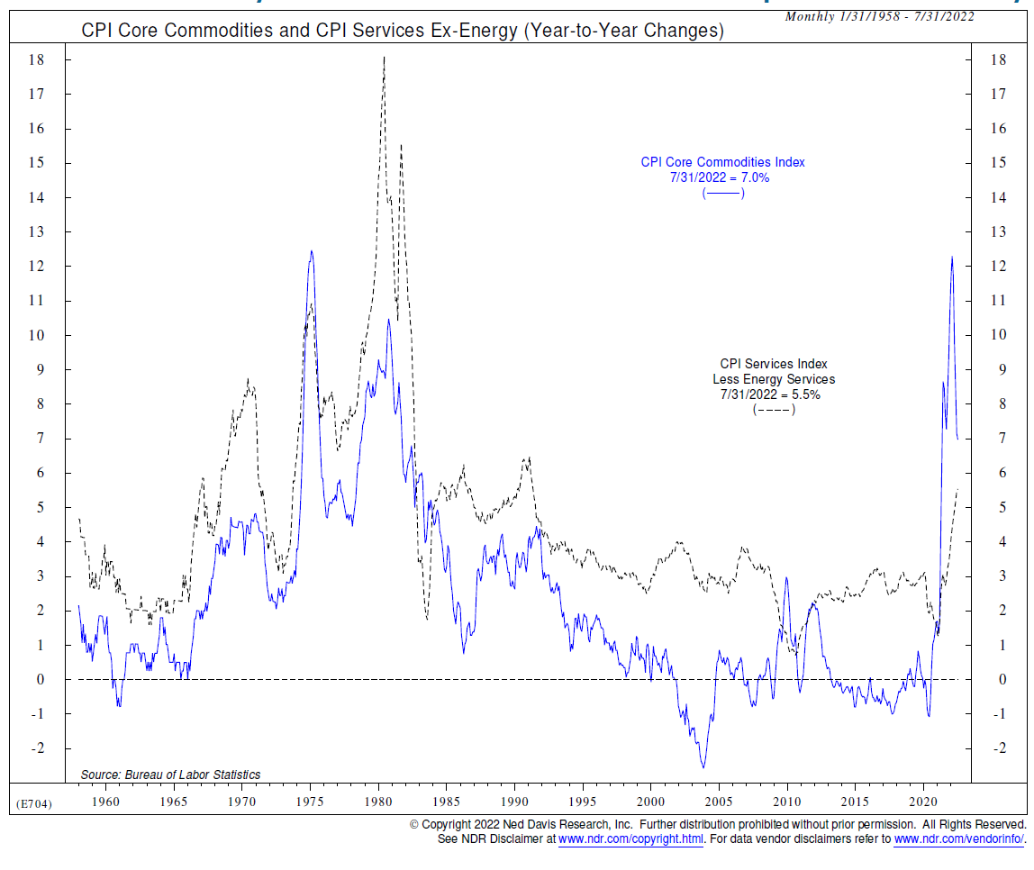
Core commodity inflation continues to fall from peak in February
The Commodity sell signal hit in June. There has been a sharp drop indicating lower inflation on the horizon.

Slide 18
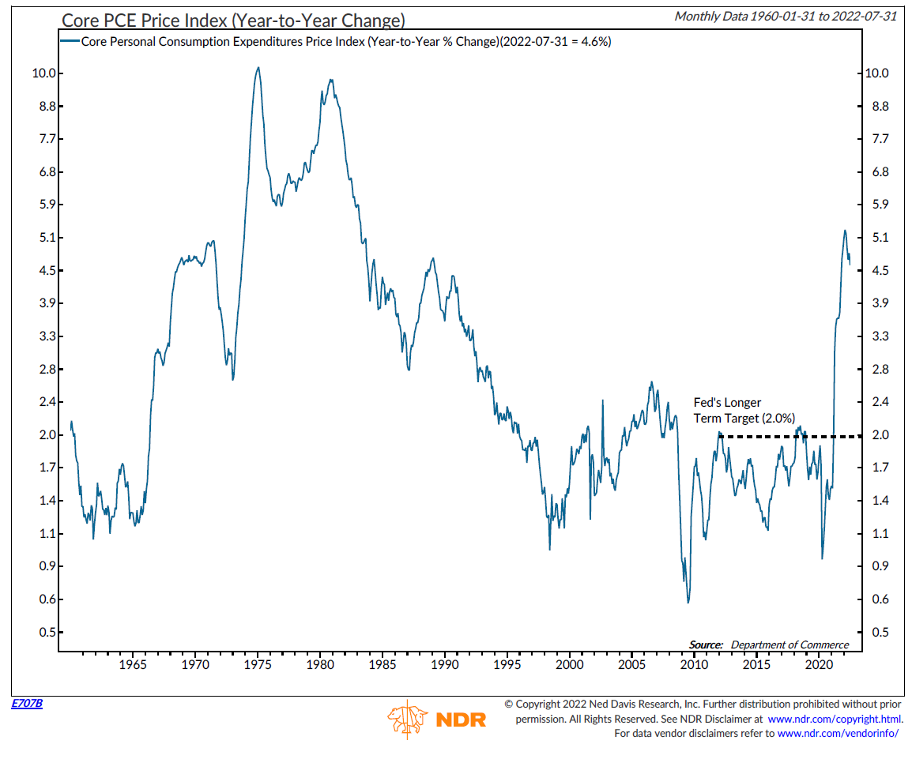
Core PCE also continues to decline from Feb. peak
While core services inflation is still rising and rents are a concern, overall core PCE inflation peaked back in February.

Slide 19
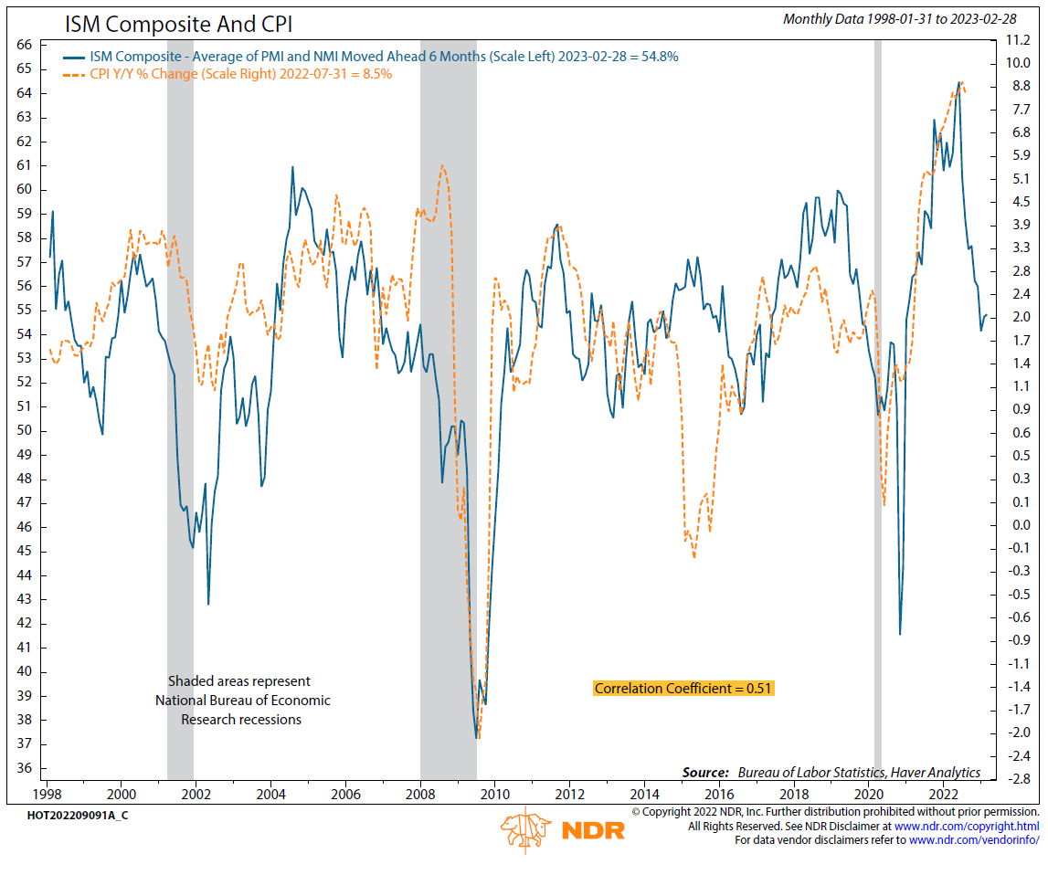
Average of PMI and NMI suggest inflation should continue falling
While the average of the ISM indices is above the neutral 50 level for now (the S&P rival indices are slightly negative), in terms of inflation, they lead typically by six months suggesting inflation should fall.

Slide 20
Less Liquidity = Less Inflation
In short, monetary policy is about liquidity. Rising rates and QT decrease liquidity. Lower liquidity will reduce money supply and velocity, bringing down inflation.

Slide 21
Worsening economic momentum will drag on corporate earnings
Source: Bloomberg; 12/31-8/31/2022

Slide 22
Global PMI’s headed lower

Slide 23
And we expected global economic momentum to slow further
Our PMI models use a series of factors, including the dollar, oil prices, DM and EM bond yields and short rates
The extent of tighter policy since from 2020/21 has already driven PMIs below 50 in many countries
We’re expecting global PMIs to head below 45 by early next year
Source: Agilis, Bloomberg. PAST PERFORMANCE IS NO INDICATION OF FUTURE RESULTS. From 12/31/2006 to 08/31/2022.

Slide 24
Agilis CPI Model: Fed Inflation target by Q3 2023
It’s logical that inflation expectations remain anchored – disinflationary forces now starting to take hold and will intensify over the next year
Using a range of forward looking economic inputs - we see a clear path towards 2% CPI by October 2023 (ignoring the near term impacts of rate policy vs what is currently priced)
Without any policy loosening, outright deflation is possible in early 2024. Additional tightening vs what’s priced will only worsen this outlook.
Source: Agilis, Bloomberg from 01/01/2001 to 08/31/2022. Agilis CPI model is based on a number of proprietary forward looking economic inputs

Slide 25
Macro Summary
Fed too low for too long, likely turning into too high for too long
Supply chains improving, new orders and PMI’s deteriorating
Real wages and income point to lower inflation
US PMI’s nearing 45 are good indicator for hitting target inflation
US positioned best globally due to strong dollar acting as inflation export
Recession and negative earnings surprises are next downdraft.

Slide 26
How does this impact portfolio positioning?
  Given the extent of economic weakness and disinflationary pressures already baked in, longer dated bonds are looking attractive on a medium term horizon
Near term inflation scenarios | Rates | Equity & Credit
Surprise to the upside | Continued upward pressure on short rates Increases the number of cuts needed to counteract slowing growth and deflation in future Supportive of further curve inversion and longer dated yields stabilising/falling | More weakness to come given rising short rates
In line with consensus | Economic weakness continues to build, meaning longer dated yields likely to start falling although with volatility at the shorter end | Economic deterioration becomes more of a focus Implies continued weakness, albeit with some rallies before an earnings driven downturn next year
Surprise to the downside | Unlikely to see enough inflation weakness in the next few months to lead to a meaningful change in shorter term policy - modest short dated yield falls expected. Longer dated yields stabilise and start to fall in line with weakening economics becoming the central focus | Short term rally expected driven by bond yields However earnings driven downturn to continue to play out next year

Slide 27
Issues we are considering at the TTUS Endowment Fund
We have been 25% underweight public equites since December of 2021; 2023 likely to be time to begin re-risking into equities; Key is how you do it.
We have been 100% dollar hedged for the last five years; likely to move to local currency in UK and EU due to currency weakness overseas.
We have been dramatically underexposed to rates, likely will begin adding to exposure and pushing out duration.
Private Assets, we have added secondaries in venture and buyout this year and are pushing into European private equity as well. These are all examples of areas that we believe have the proverbial wind at our back.
Remember, it is not about calling the bottom, but buying over time to ensure you are purchasing assets through the bottom of the cycle.

Slide 28
Q&A

