Slide 1
TLFFRA
October 4, 2022
Kevin Vandolder, CFA®
Consultant
Catherine Nicholas
Founder and Chief Investment Officer
Mason King, CFA®
Portfolio Manager and Director of Public Equities
Benjamin Monkiewicz
Partner and Portfolio Manager
The Pandemic Has Become an Endemic:
“Time to Revisit Public Equities and Bonds?”

Slide 2
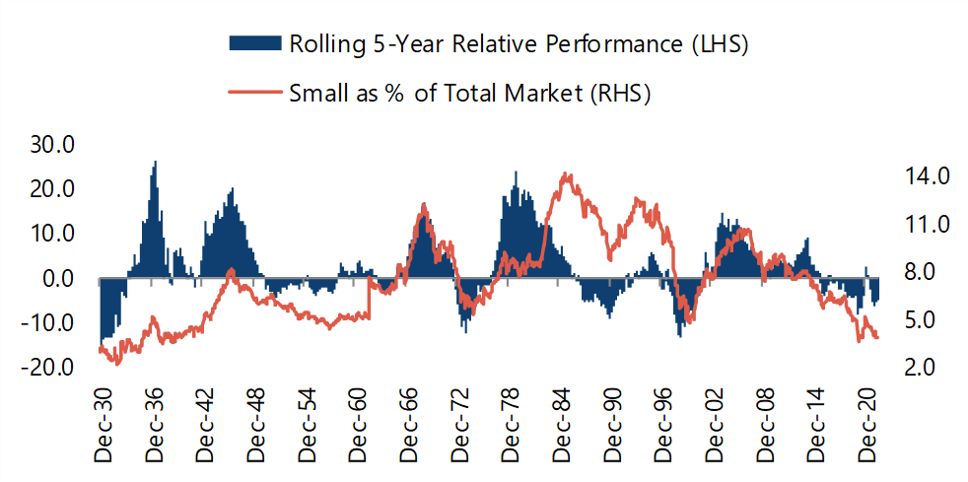
Small-Cap Stocks Represent 3.8% of US Equity Markets, Below ’99 Levels
12th percentile
Rolling 5-year relative performance
% of US Market
3.8%
Source: Center for Research in Security Prices (CRSP®), The University of Chicago Booth School of Business; Jefferies. Supplemental information. Not an investment recommendation. Results may vary for different time periods. Note: Past performance is no guarantee of future results.
MEC_SC_0722

Slide 3
Small Cap Growth Relative Forward Valuations vs. Large Cap Growth Are Compelling
20 Yrs Forward P/Es
Russell 2000 Growth Index vs. Russell 1000 Growth Index
Sept. 2002 to Aug. 2022
Relative Forward PE ratio
20 Yr. Avg. = 1.11
1.04
Source: Jefferies, FTSE/Russell, Nicholas Investment Partners. Supplemental information. Based on historical data of the Russell 2000 Growth and Russell 1000I Growth Index. The Russell Indices are unmanaged indices of common stock performance. Not an investment recommendation. Results may vary for different time periods. Past performance is no guarantee of future results.
MEC_SC_0722

Slide 4
The Power of Staying Fully Invested
Russell 2000 Growth Performance
January 1, 2000 to August 31, 2022
Source: Bloomberg, FTSE/Russell, Nicholas Investment Partners. Supplemental information. Based on historical data of the Russell 2000 Growth Index. The Russell 2000 Growth is an unmanaged index of common stock performance. Not an investment recommendation. Results may vary for different time periods. Past performance is no guarantee of future results.
MEC_SC_0722

Slide 5
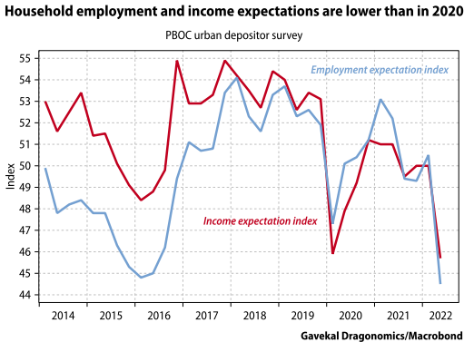
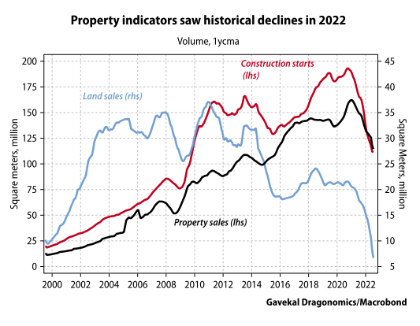
China’s Economic Stress
Sentiment Indicators at Lows
Youth Unemployment High
Zero-COVID Policies’ Impact
Property Boom to Bubble to Bust (?)
Demographic Headwinds
Urbanization Slowing
Impacts on Wealth Creation
Global Impact on Demand and Growth
China’s Fiscal and Monetary Response
Source: GaveKal Dragonomics

Slide 6
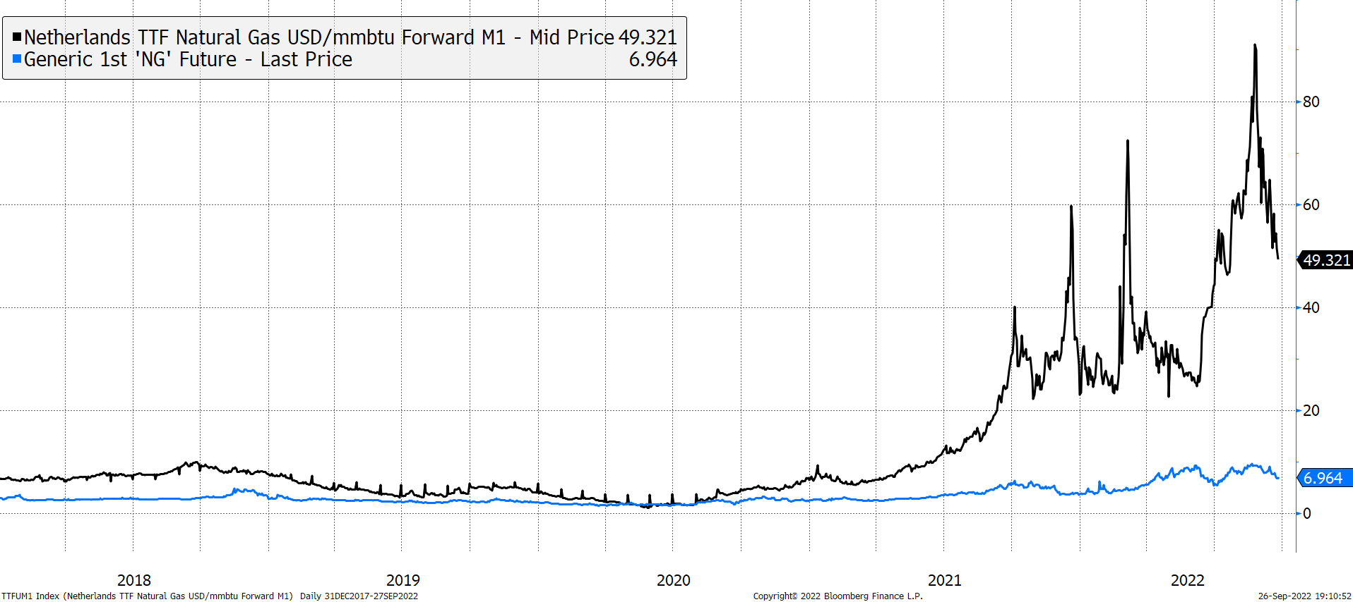
Europe’s Energy Debacle
Increased Dependence upon Russia
Necessity of “Bridge Fuels”
Challenges with Renewables
Limitations of Infrastructure and LNG
Responses to Curtail Demand
Eroding Competitive Advantages
Economic Costs of Policy Responses
Currency Headwinds & Inflationary
Natural Gas Storage: Threading a Needle
New Tone to Energy Debate
Source: Bloomberg LP

Slide 7
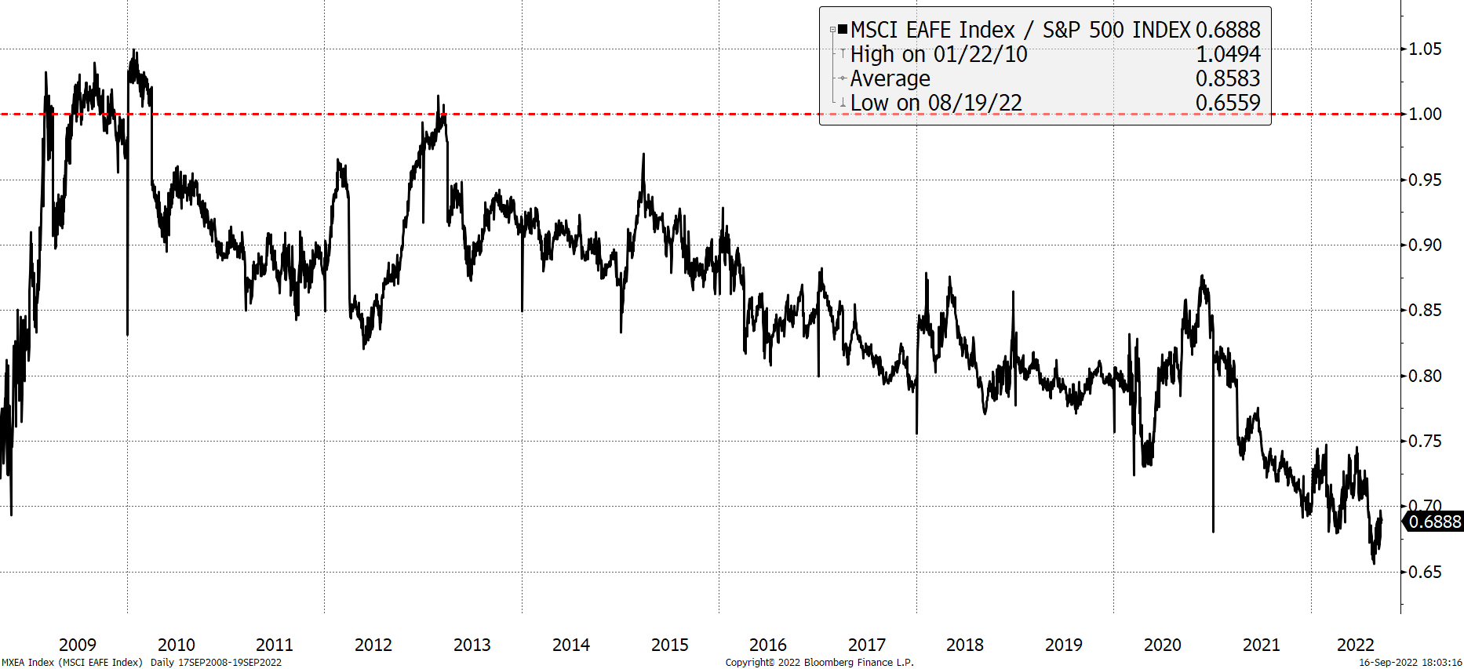
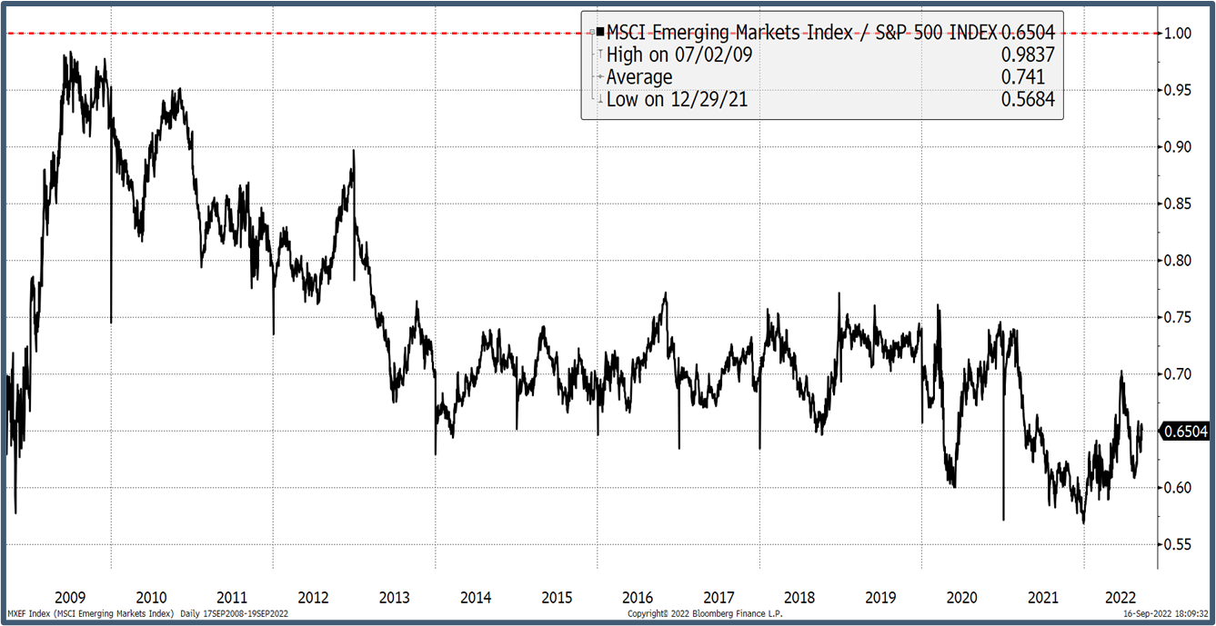
Valuation Discount for International
Relative Multiples at Steep Discounts
Weak Currency Impact
Capital Flows to “Safe Havens”
Fundamental Components of Discount
Cyclical Components of Discount
Global Recession Likely
Earnings Revisions Ahead
Markets: A Discounting Mechanism
Source: Bloomberg LP

Slide 8
Summary
OUTLOOK
  GDP Forecasts Coming Down
  Earnings Revisions Starting
  Inflation Persistent and Costs of Capital Increasing
  Challenged Monetary Policy & Limited Fiscal “Space”
  Markets Likely Remain Volatile
  Recovery Ahead But Likely Slow
OPPORTUNITIES
  More Attractive Valuations
  Be Selective: High Quality and Durability of Earnings
  Play to Strength of Companies and Local Markets
  Growth Discounted: “Behaving” Better
  High Return Profiles Generate Real Returns
BLACK SWANS
  Russia-Ukraine Escalation
  Pandemic Risks
  Persistent Inflation and Central Bank
  Deterioration of Credit into Crisis

Slide 9
Historical Fiscal Stimulus
Events | Amount | % of GDP | Today’s Dollars | Date
COVID-19 | $6.7 T | 29.5% | $6.7 T | 2020-2021
Great Financial Crisis | $939 B | 3.2% | $1.2 T | 2008-2009
World War II | $350 B | 30.5% | $6.8 T | 1939-1945
Great Depression | $42 B | 7.5% | $825 B | 1933-1939
Mizuho Group, International Monetary Fund, CNBC

Slide 10
Money Supply Long Term Growth
2.9%
The data used to create the long-term year over year growth rate was compiled from data published by the Federal Reserve Historical Monetary Aggregate Data. The monthly series from Jan 1948 until November 1980 was compiled from the M2SA and M2SL series and is used to calculate the year over year annualized growth rate. After November 1980, the weekly data series for M2 is used to calculate the year over year annual growth rate.
As of September 5, 2022 | Federal Reserve

Slide 11
Inventories Have Blown Past Pre-COVID Trend
Inventory Rebuild
Straight Line Extrapolated Growth
COVID Supply Shock
As of June 30, 2022| Bloomberg

Slide 12
Disclosures
Nicholas Investment Partners, L.P. (“Nicholas”) is an independent investment adviser registered with the SEC. Registration with the SEC does not imply a certain level of skill or training. The firm maintains a complete list and description of performance composites, which is available upon request. Policies for valuing portfolios, calculating performance, and preparing presentations are available upon request. Past performance is no guarantee of future results. This information is intended for institutions, consultants and qualified investors only. No part of this material may be copied or duplicated or distributed to any third party without written consent.
Nicholas does not guarantee the success of any investment product. There are risks associated with all investments and returns will vary over time due to many factors such as changing market conditions, liquidity, economic and other factors. The value of investments can go down as well as up, and a loss of principal may occur. Although Nicholas attempts to limit various risks, risk management does not imply low risk. All risk models are inherently limited and subject to changes in economic, political and market conditions, as well as changes in the strategies’ holdings, among other things, which could affect the risk profile of any portfolio managed by Nicholas. Small- and mid-cap companies may be subject to a higher-degree of risk than larger more established companies’ securities. The liquidity of the markets for these small and mid-cap companies may adversely affect the value of these investments. Concentrated or sector strategies are expected to maintain higher exposures to a limited number of securities or sectors which could increase the volatility, market, liquidity and other risks of the strategy.
Some information herein reflects general market commentary and the current opinions of the author which are subject to change without notice. It is provided for general informational purposes only and does not represent investment, legal, regulatory or tax advice and should not be construed as a recommendation of any security, strategy or investment product. There is no guarantee any opinion, forecast, or objective will be achieved in the future. The information, charts and reports contained herein are unaudited. Although some information contained herein was obtained from recognized and trusted sources believed to be reliable, its accuracy and completeness cannot be guaranteed. Unless otherwise noted, Nicholas is the source of illustrations. References to specific securities, issuers and market sectors are for illustrative purposes only. Nicholas does not undertake to keep the recipients of this report advised of future developments or of changes in any of the matters discussed in this report.
Nicholas used third-party information in the preparation of the characteristics and market environment charts. While Nicholas believes the third-party information was obtained from reliable sources, we cannot guarantee the accuracy, adequacy or completeness of the information obtained from these sources.
Index returns are provided to represent the investment environment existing during the time periods shown. Other measurement periods will yield different results and are provided for comparison purposes only. The indices are fully invested, which includes the reinvestment of income, unless otherwise noted. The returns for the index do not include any transaction costs, management fees or other costs. Investors may not make direct investments into any index and may not represent the investment style of any Nicholas Investment Partners strategy. Investors should consider comparing the performance of any potential investment to other benchmarks and indices that are representative of their particular investment objectives, horizons and risk tolerances.
Frank Russell Company is the source and owner of the trademarks, service marks and copyrights related to the Russell Indexes. Russell ® is a trademark of Russell Investment Group.
The Russell 2000® Index is a market-capitalization weighted index that measures the performance of the 2,000 smallest companies in the Russell 3000® Index, which represents approximately 8% of the total market capitalization of the Russell 3000 Index. You cannot invest directly in an index.
The Russell 2000 Growth Index is a market-capitalization weighted index that measures the performance of the small-cap growth segment of the US equity universe. It includes those Russell 2000 companies with higher price-to-book ratios and higher forecasted growth values. The Russell 2000 Growth Index is constructed to provide a comprehensive and unbiased barometer for the small-cap growth segment. The Index is completely reconstituted annually to ensure larger stocks do not distort the performance and characteristics of the true small-cap opportunity set and that the represented companies continue to reflect growth characteristics. Index returns include the effect of dividends and income which are reinvested daily.
MEC_SC_0722

Slide 13
Disclosures
The Russell 1000 Index measures the performance of the large-cap segment of the US equity universe. It is a subset of the Russell 3000 Index and includes approximately 1,000 of the largest securities based on a combination of their market cap and current index membership. The Russell 1000 represents approximately 92% of the US market. The Russell 1000 Index is constructed to provide a comprehensive and unbiased barometer for the large-cap segment and is completely reconstituted annually to ensure new and growing equities are reflected. Index returns include the effect of dividends and income which are reinvested daily.
The Russell 1000 Growth Index measures the performance of the large-cap growth segment of the US equity universe. It includes those Russell 1000 companies with higher price-to-book ratios and higher forecasted growth values. The Russell 1000 Growth Index is constructed to provide a comprehensive and unbiased barometer for the large-cap growth segment. The Index is completely reconstituted annually to ensure new and growing equities are included and that the represented companies continue to reflect growth characteristics. Index returns include the effect of dividends and income which are reinvested daily.
MEC_SC_0722

