Slide 1
“Well, I’ve Changed My Mind…” Legal Issues That Arise When Trustees and Members Make Changes and Other Hot Topics
Texas Local Fire Fighters’ Retirement Act (TLFFRA) Educational Conference – October 4, 2022

Slide 2
Overview
Look at legal issues arising when trustees, members or beneficiaries change decisions on pension matters
Hot Topics in Public Pension Circles

Slide 3
Well, I’ve Changed My Mind!!
When looking across the spectrum of various legal issues that arise with public pension funds, many arise when a change is made due to a change in mind or heart.
This change can be made by:
Trustees with respect to plan design or operation
Members with respect to their lives and/or benefits

Slide 4
Changes by Trustees
Well, we changed our mind…
We want to change our plan!!

Slide 5
Changes by Trustees
Three step process for amending of plan:
Board approval
Actuarial approval
Member election

Slide 6
Changes by Trustees
Practically-
Need actuarial involvement up front on any change
Board approves ballot with respect to benefit change
Not all plan changes need a vote!
Ex.: Operational issues, IRS requirements, corrective changes

Slide 7
Changes by Trustees
Ballot-
Needs a clear description of the benefit change and what is being voted on (yes or no vs. Option #1 or #2)
Secret ballot (paper? electronic?)
Approval of majority voting and majority of members must vote

Slide 8
Changes by Trustees
Adoption of Ballot and Amendment of Plan-
Board must certify election results AND approve plan amendment with change
Board has ultimate discretion

Slide 9
Changes by Trustees
Well, we changed our mind….
We want to fire our lawyer!!

Slide 10
Changes by Trustees
Change of Vendor-
In changing a vendor, review termination provision prior to the outset
Process of selection is important

Slide 11
Changes by Trustees
Vendor Selection Process-
Obtain reasonable information to make informed decisions
RFQs and RFPs are a common method, but not absolute requirement for TLFFRA fund

Slide 12
Changes by Trustees
Vendor Selection Process-
Key aspects of vendor contract
Scope of services
Fees
Liability provisions
Governmental concerns
Termination clause

Slide 13
Changes by Trustees
Well, we changed our mind.
We want to talk to our lawyer and fire our actuary…TODAY!!

Slide 14
Changes by Trustees
Texas Open Meetings Act-
Any deliberation by a quorum of the Board must be done in open meeting
Open meetings must be posted 72 hours in advance

Slide 15
Changes by Trustees
Meeting Posting and Closed Sessions-
Needs to include all items to be discussed
Items not on agenda cannot be discussed
Only certain items permitted by TOMA can go into closed session
Ex. Consultation with attorney; disability determinations

Slide 16
Changes by Trustees
Well, we changed our mind….
We want to keep our actuary and change our actuarial assumptions!!

Slide 17
Changes by Trustees
Change in Actuarial Assumptions-
Significant fiduciary action of the Board
Exclusive Benefit Rule---wear the right hat!
Duty of Prudence---all about the process

Slide 18
Changes by Trustees
Change in Actuarial Assumptions-
The Process
Experience study—evaluating assumptions vs. actual experience
Assumption changes should be recommended by your actuary, but ask questions
Understanding and addressing possible consequences to the Fund due to changes
Try to keep the results from driving the process

Slide 19
Changes by Members
Well, I’ve changed my mind…
I want a divorce!

Slide 20
Changes by Members
Divorce and Pension-
QDROs
Change in beneficiary designations

Slide 21
Changes by Members
QDROs-
Qualified Domestic Relations Order entered into by Court
Required in order to provide ex-spouse (alternate payee) an interest in the pension
QDROs must be approved by the Fund
Fund may reject the QDRO if it does not satisfy certain requirements and cannot be administered under the Fund

Slide 22
Changes by Members
QDROs-
Typically divide pension based on community property interest held by the parties
Community property interest often based on years served or contributions made while married
However, split is ultimately up to the parties and the judge

Slide 23
Changes by Members
Form QDRO-
State law allows Fund to establish a form QDRO
QDRO can be rejected if does not follow a Board-approved form, even if it can be administered
Form allows for streamline of process and administration

Slide 24
Changes by Members
Change in Beneficiary-
Some Funds allow beneficiary designations for a survivor benefit or for DROP account
Member often names a spouse as beneficiary
Member may forget to change designation if divorced and any survivor benefit or DROP could go to ex-spouse
Some Funds automatically negate beneficiary designations where spouse is named and divorce occurs

Slide 25
Changes by Members
Well, I’ve changed my mind…
I don’t want my ex-spouse to get my pension!

Slide 26
Changes by Members
Revocation of QDRO-
As discussed, a QDRO is a court order
If Fund has approved a QDRO, it must follow the QDRO and cannot alter based on parties’ intent

Slide 27
Changes by Members
Revocation of QDRO-
If parties want to change the terms of an existing QDRO, they must first go to the Court and have it revoked
Revocation must be received by the Fund before existing division or payments are changed

Slide 28
Changes by Members
Well, I’ve changed my mind…..
I want to return to work!

Slide 29
Changes by Members
Return to Work-
Must have a bona fide termination of employment to retire and begin your pension
Returning immediately to work or after a brief period can be problematic from IRS compliance standpoint

Slide 30
Changes by Members
Return to Work-
No rejoining department or postretirement service credit available for a TLFFRA retiree
A member who has only withdrawn contributions can return to work and may be able to deposit withdrawn contributions to obtain lost service contributions depending on the plan terms
A member who has withdrawn contributions can purchase service at another TLFFRA department based on contribution rate for relevant period at the new department with 8% interest (Note: City must contribute as well)

Slide 31
Changes by Members
Return to Work-
Retired member can work at a non-TLFFRA department (Ex.: TCDRS, TMRS)
Service purchase for previous TLFFRA service may be a possibility an new employer, but cannot receive credit under two Texas retirement systems for the same service

Slide 32
Hot Topics
Actuarial Determined Contributions
Use of the “ADC” vs flat rate contributions
ADC=Normal Cost plus payment on unfunded liabilities
Focus of PRB and key aspect of legislative pension reform, including inclusion in FSRP process
Legislation to apply to all plans?
Maybe not pure ADC, but some floating rate based on funded status

Slide 33
Hot Topics
Disability Determinations and PTSD
Increase in applications for psychological disability
Many disability application and review processes geared towards physical disabilities
Ensuring proper review of application by qualified medical professionals
Change in disability standards becomes key
Ability to perform duties of firefighter vs. ability to do any job for which otherwise suited

Slide 34
Hot Topics
Data Security
Public pension plans have been a target
Financial-like institution but without same controls
Significant focus of many larger funds to curtail possible breaches involving personal information and/or assets
What about smaller plans?
Identify areas of where breach could occur
Appropriate diligence and agreement with vendors
If a breach occurs, be sure and follow appropriate legal steps relating to notification and attempt at recovery

Slide 35
Hot Topics
Divestiture Statutes for Statewide Plans
Texas statewide systems subject to statutes identical in form that prohibit and require divestiture of certain investments
Investments in Sudan and Iran
Companies that Boycott Israel
Financial Companies that Boycott Energy Companies
Statutes do not apply to TLFFRA plans but are a blueprint for a nationwide trend that could trickle down
Fiduciary implications of exclusive benefit rule

Slide 36
Questions?

Slide 37
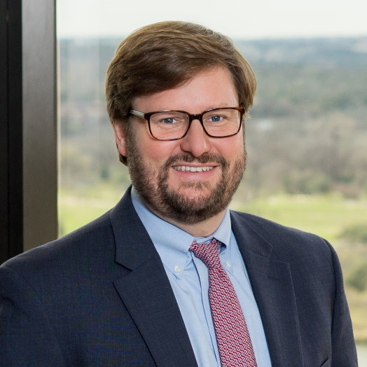
Chuck Campbell
Partner, Austin
512.236.2263
ccampbell@jw.com

